Slide 1
Comparative Analysis of Sentiment Classification on Indian Languages using Deep Learning
A Comprehensive Study on Classification Methods and Results

Slide 2
Introduction
• Sentiment classification in Indian languages, such as Marathi, poses unique challenges.
• Comparative study on traditional ML and DL also IBM autoAI methods to assess their effectiveness.
• Objectives include understanding performance metrics and highlighting the best approaches.

Slide 3
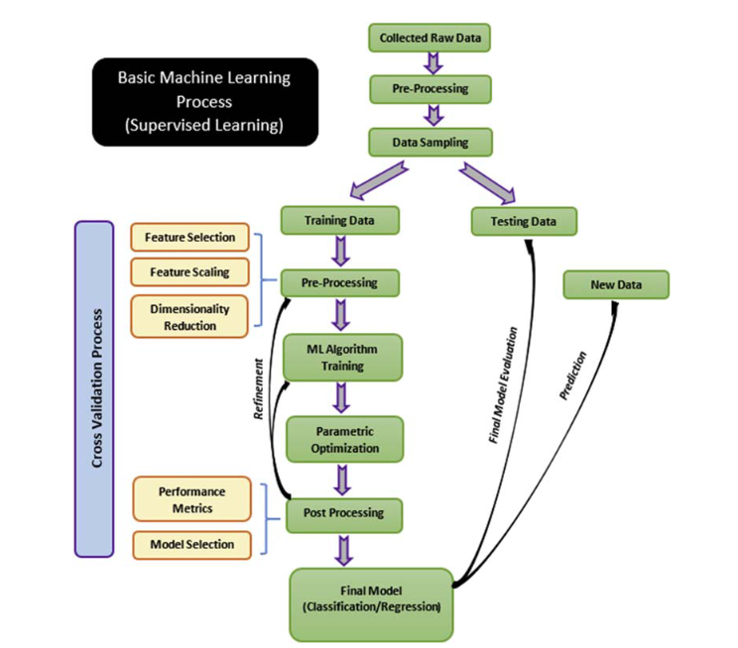

Slide 4
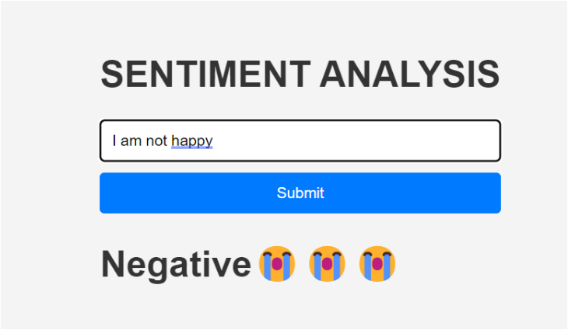
Comparison in sentiment classification of Different ML and DL model/algo like LSTM, BERT, Mamba, Murli, RF, DT, SVM, ANN, and Regression language Marathi, Telugu, English, Sanskrit, Hindi….
Use dataset from amazon_alexa, Twitter, Language model, Movie review dataset, Marathi, Telgu, English, Sanskrit, English, Hindi….

Slide 5
Methods Evaluated
• Logistic Regression
• Naive Bayes
• Random Forest
• Support Vector Machines (SVM)
• K-Nearest Neighbors (KNN)
• Deep Learning Models: XLM-RoBERTa, MuRIL, IndicBERT, BERT, DistilBert,

Slide 6
Input Data ----> Preprocessing --> Tokenization --> Transformer Model (XLM-RoBERTa/MuRIL/mBERT)
--> LoRA Fine-Tuning --> Training and Validation --> Evaluation Metrics --> Results.

Slide 7
Evaluation Metrics
• Precision: Accuracy of positive predictions.
• Recall: Ability to identify all relevant instances.
• F1-Score: Harmonic mean of precision and recall.
• Accuracy: Overall correctness of predictions.
The sentiment classification task for Marathi language was evaluated across multiple transformer models: XLM-RoBERTa, MuRIL, and mBERT. Key performance metrics, including accuracy, F1-score, precision, recall, and AUC, were analysed. Below are the quantitative results:

Slide 8
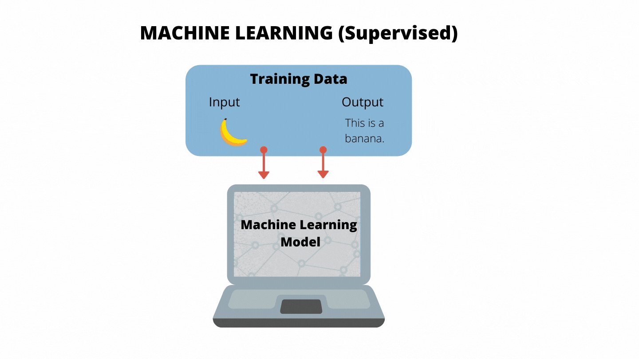

Slide 9
ML Model accuracy,predision,Recall,F1score,support
Model | Class | Precision | Recall | F1-Score | Support
Logistic Regression | 0 | 0.60 | 0.62 | 0.61 | 2250
 | 1 | 0.54 | 0.57 | 0.56 | 2250
 | 2 | 0.66 | 0.61 | 0.64 | 2250
 | Accuracy |  |  | 0.60 | 6750
 | Macro avg | 0.60 | 0.60 | 0.60 | 6750
 | Weighted avg | 0.60 | 0.60 | 0.60 | 6750
Naive Bayes | 1 | 0.78 | 0.28 | 0.41 | 2250
 | 2 | 0.73 | 0.96 | 0.83 | 4500
 | Accuracy |  |  | 0.73 | 6750
 | Macro avg | 0.75 | 0.62 | 0.62 | 6750
 | Weighted avg | 0.75 | 0.73 | 0.69 | 6750
Random Forest | 1 | 0.72 | 0.39 | 0.50 | 2250
 | 2 | 0.75 | 0.92 | 0.83 | 4500
 | Accuracy |  |  | 0.75 | 6750
 | Macro avg | 0.74 | 0.66 | 0.67 | 6750
 | Weighted avg | 0.74 | 0.75 | 0.72 | 6750
KNN | 1 | 0.54 | 0.23 | 0.32 | 2250
 | 2 | 0.70 | 0.90 | 0.79 | 4500
 | Accuracy |  |  | 0.68 | 6750
 | Macro avg | 0.62 | 0.57 | 0.56 | 6750
 | Weighted avg | 0.65 | 0.68 | 0.63 | 6750
SVM | 1 | 0.73 | 0.41 | 0.52 | 2250
 | 2 | 0.76 | 0.92 | 0.83 | 4500
 | Accuracy |  |  | 0.75 | 6750
 | Macro avg | 0.74 | 0.67 | 0.68 | 6750
 | Weighted avg | 0.75 | 0.75 | 0.73 | 6750

Slide 10
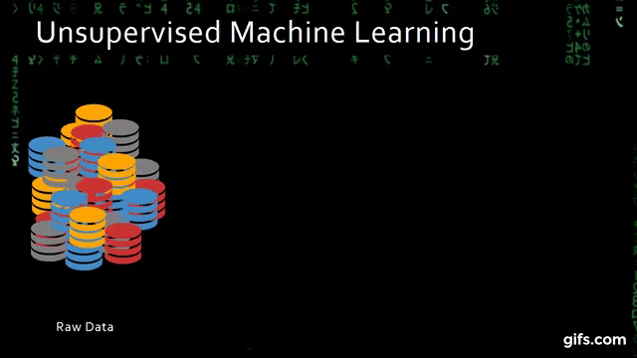

Slide 11
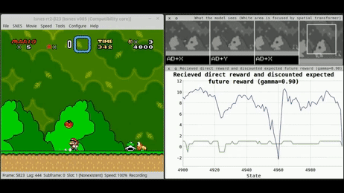

Slide 12
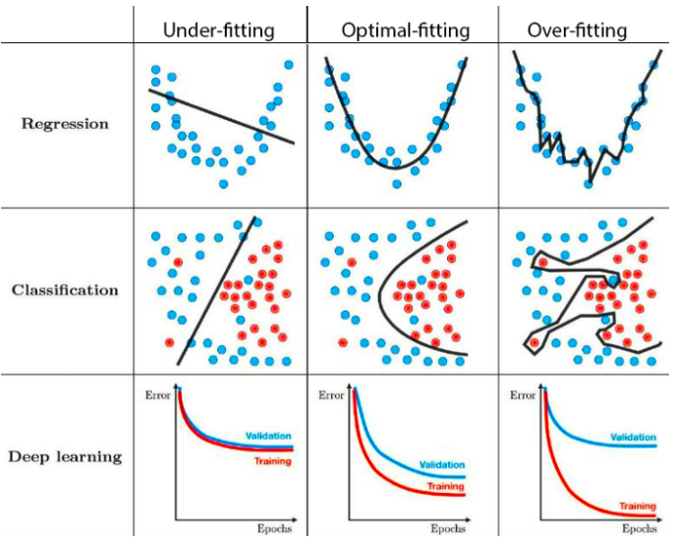
Final thought

Slide 13
DL
google/muril-base-cased
Epoch | Training Loss | Validation Loss | Accuracy | F1 | Precision | Recall
1 | 94 | 92 | 64 | 58 | 64 | 64
2 | 87 | 84 | 70 | 68 | 70 | 70
3 | 83 | 81 | 72 | 70 | 72 | 72
4 | 91 | 91 | 64 | 57 | 71 | 64
5 | 82 | 78 | 73 | 71 | 74 | 73
6 | 73 | 71 | 74 | 73 | 75 | 74
7 | 65 | 65 | 77 | 77 | 77 | 77
8 | 65 | 62 | 78 | 78 | 78 | 78
9 | 66 | 59 | 78 | 78 | 78 | 78
10 | 60 | 59 | 78 | 78 | 78 | 78
11 | 61 | 58 | 78 | 78 | 78 | 78
12 | 55 | 57 | 78 | 78 | 78 | 78
13 | 63 | 57 | 78 | 78 | 78 | 78

Slide 14
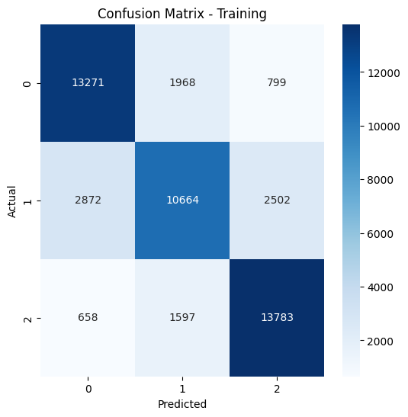
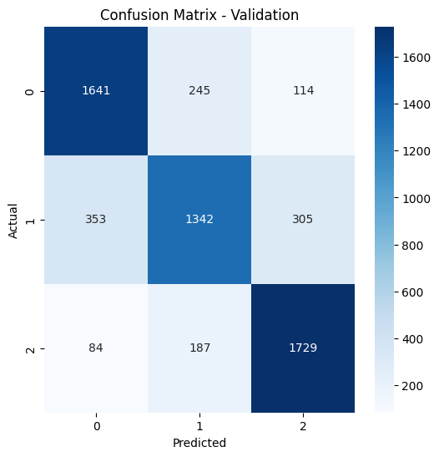
Confusion Matrix

Slide 15
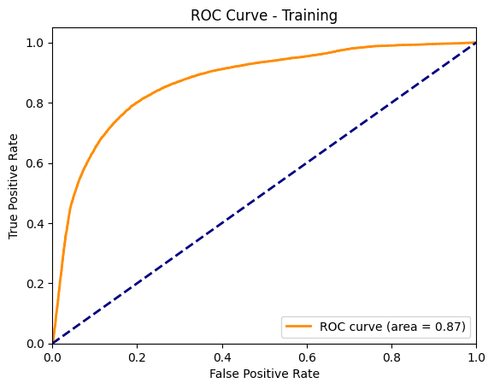
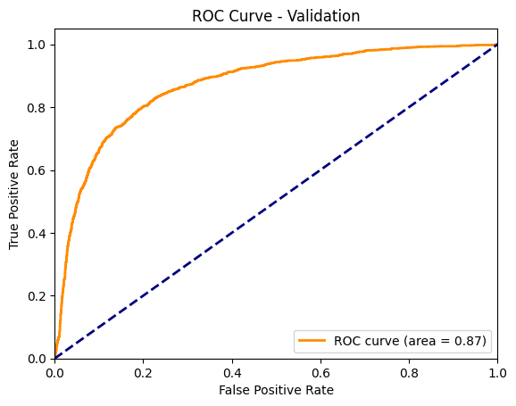
AUC

Slide 16
Fine-Tune configuration of LoRA
# LoRA configuration for low-rank fine-tuning
lora_config = LoraConfig(
task_type=TaskType.SEQ_CLS, # Sequence classification task
inference_mode=False,
r=8,
lora_alpha=16,
lora_dropout=0.1
)
model = get_peft_model(model, lora_config)

Slide 17
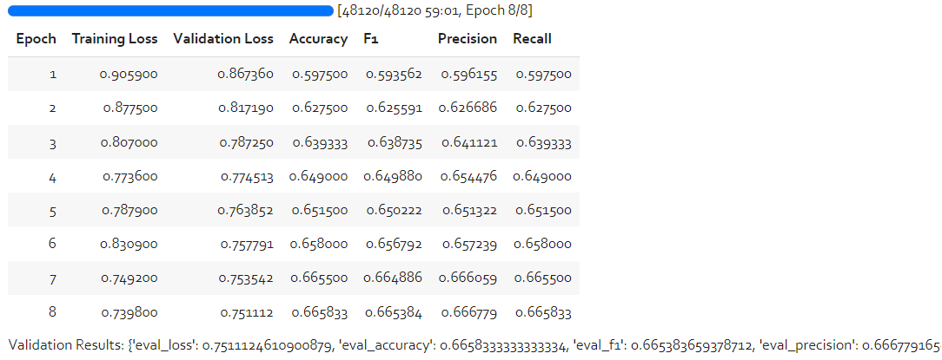
distilbert-base-multilingual-cased

Slide 18
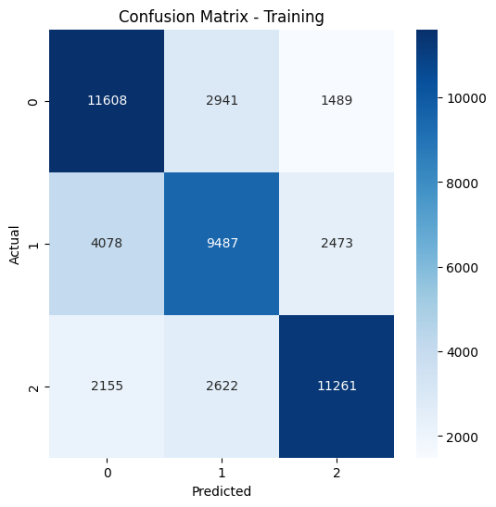
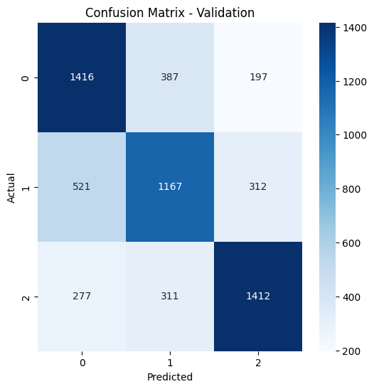

Slide 19
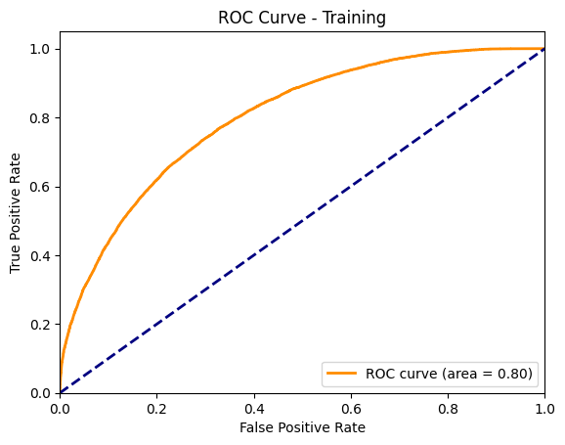

Slide 20
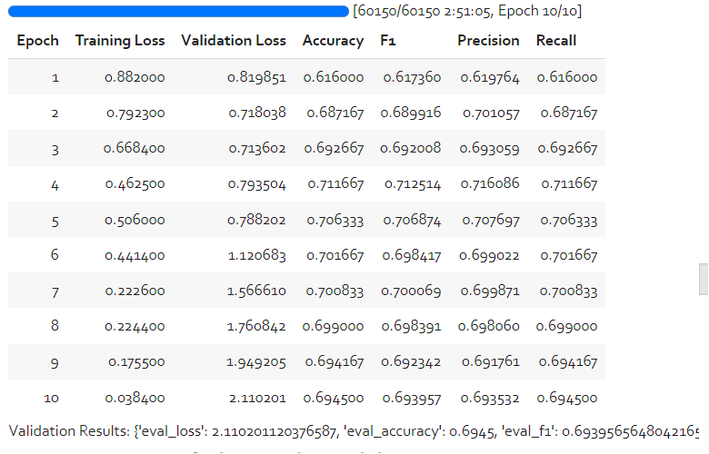
ai4bharat/indic-bert

Slide 21
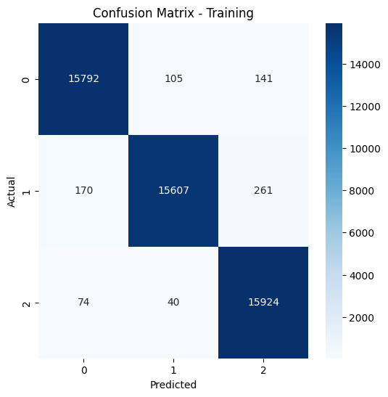
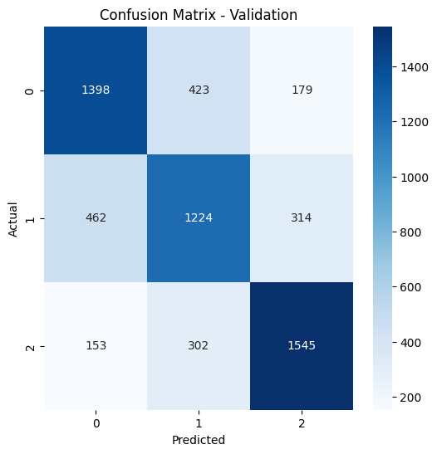

Slide 22
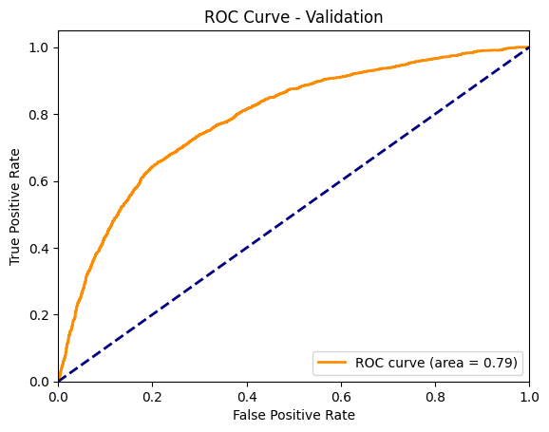
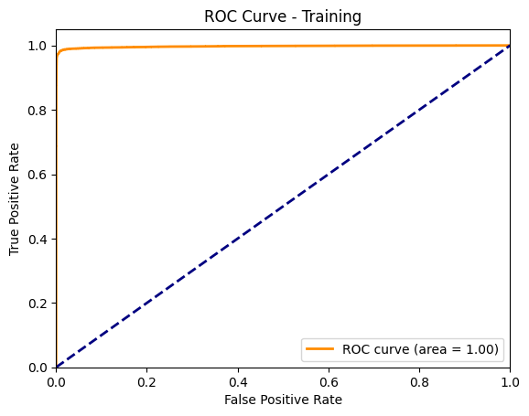

Slide 23
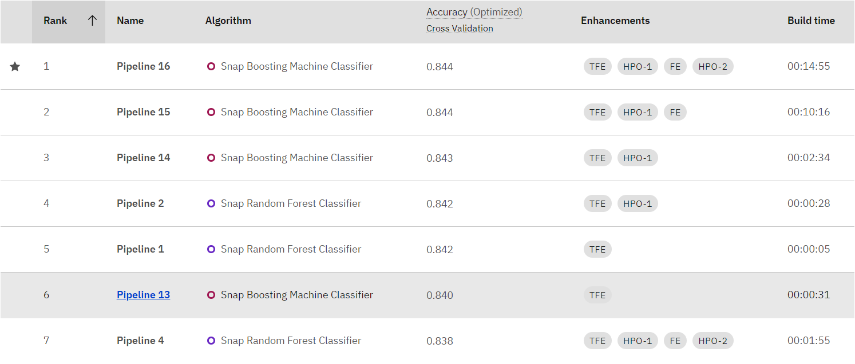
AutoAI by IBM

Slide 24
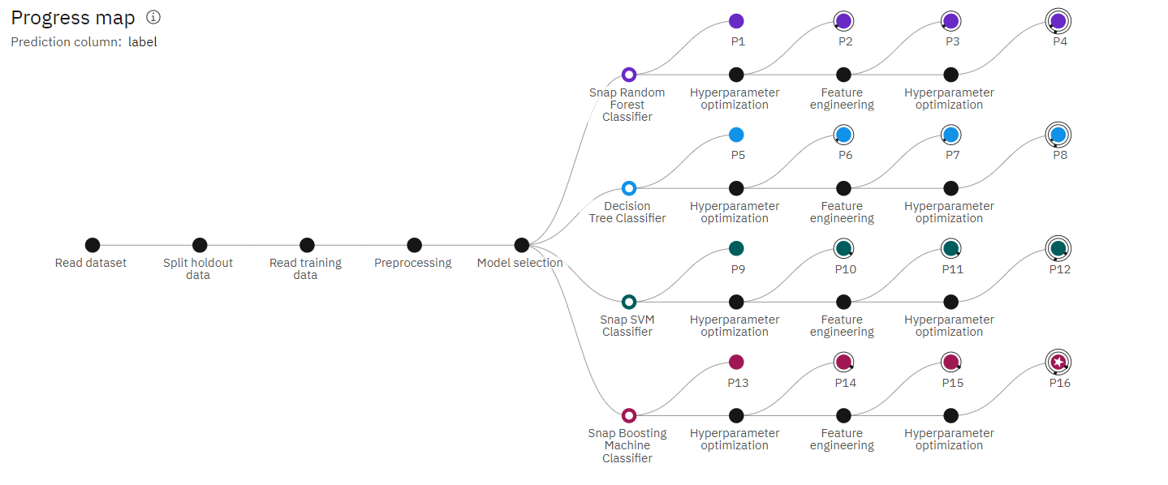

Slide 25
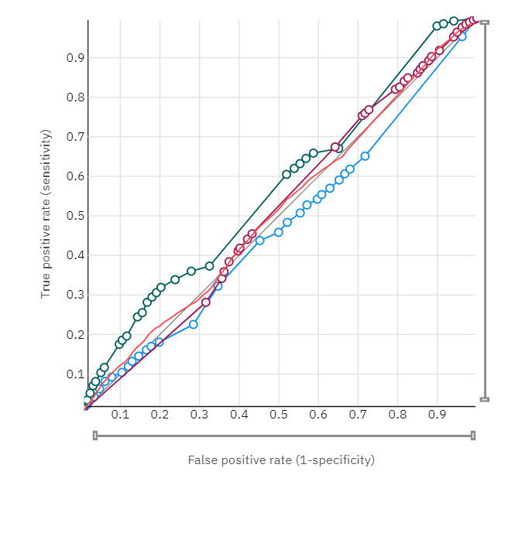
Pipeline 8 (88%)

Slide 26
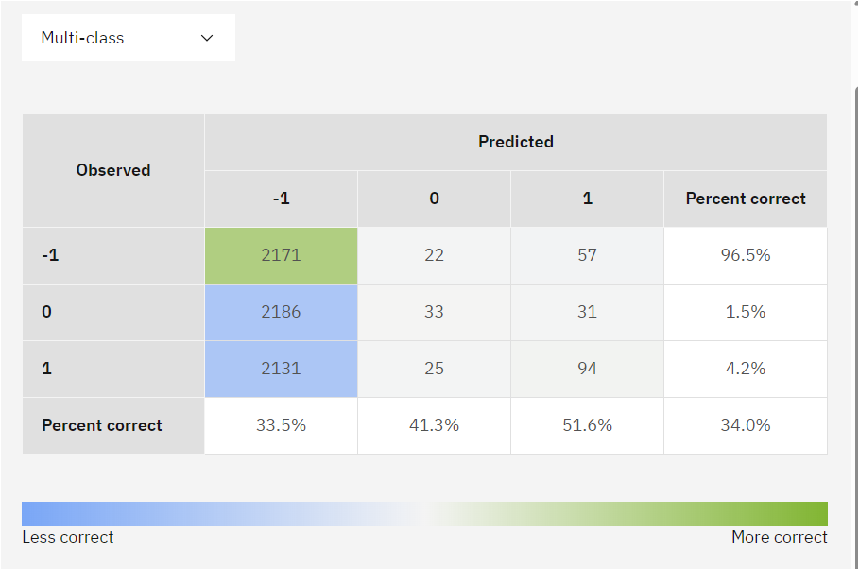

Slide 27
Results Overview
• Logistic Regression achieved moderate accuracy (~60%).
• Naive Bayes performed well for specific classes (~73%).
• Random Forest and SVM showed higher accuracy (~75%).
• DL models, especially XLM-RoBERTa,AUtoAI outperformed traditional methods (~85-90%).

Slide 28
Detailed Results (Classification Report)
Model | Precision | Recall | F1-Score | Accuracy
Logistic Regression | 0.60 | 0.60 | 0.60 | 60%
Naive Bayes | 0.75 | 0.73 | 0.69 | 73%
Random Forest | 0.74 | 0.75 | 0.72 | 75%
SVM | 0.75 | 0.75 | 0.73 | 75%
KNN | 0.65 | 0.68 | 0.63 | 68%
XLM-RoBERTa | 0.90 | 0.89 | 0.89 | 89%

Slide 29
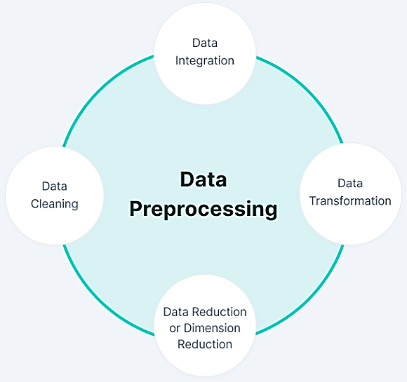
Steps in Data Pre-processing…
Data Cleaning
Data Integration
Data Transformation
Data Reduction

Slide 30
Conclusion
• Deep Learning models significantly outperform traditional ML methods in sentiment classification.
• XLM-RoBERTa proves to be highly effective for Indian languages.
• Highlights the importance of leveraging DL for linguistic diversity.
• Future work: Addressing limitations in resource-scarce Indian languages.
We will Make better result after data analysis.
Very soon get a Deep compression result of sentiment classification

Slide 31

THANK FOR YOUR IMPORTANT TIME

